Slide 1
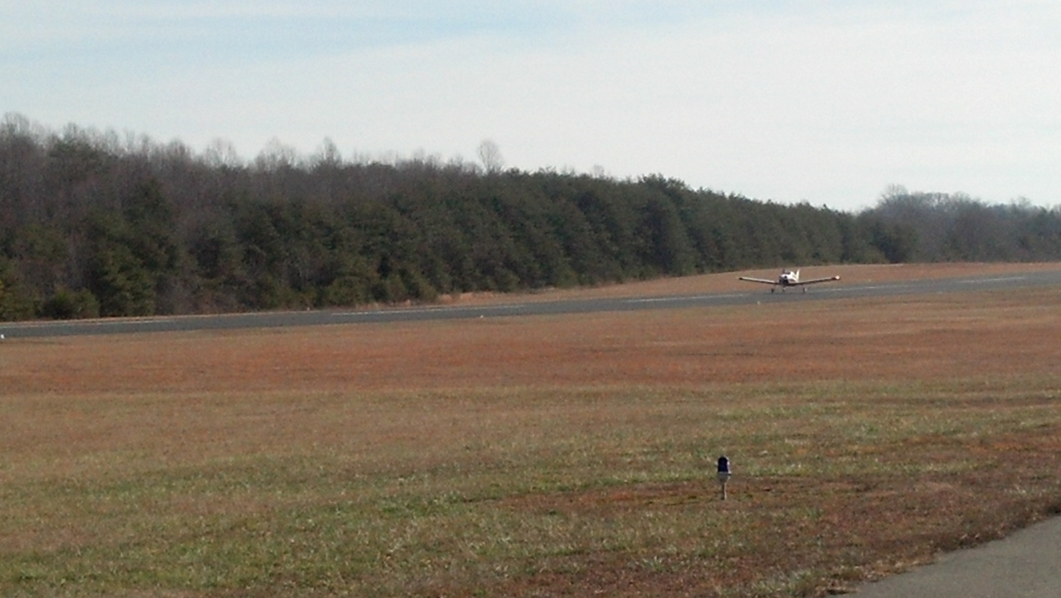

Slide 3
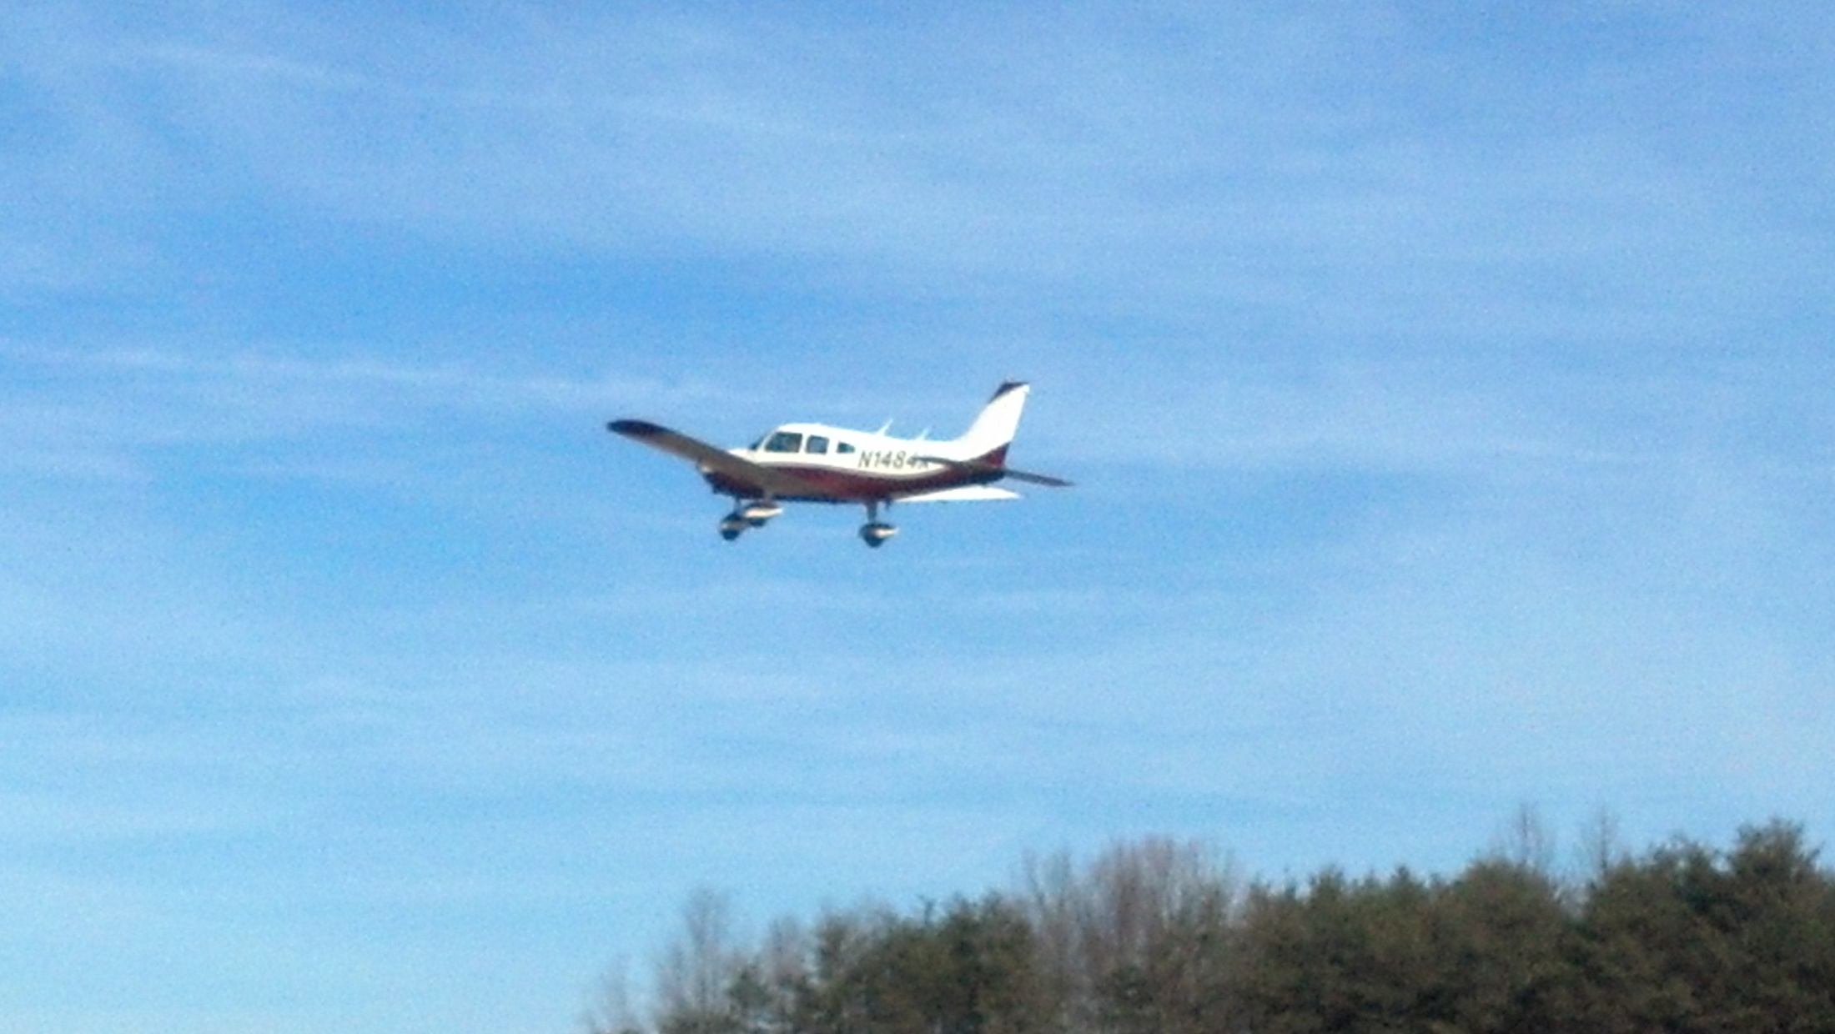
2

Slide 4
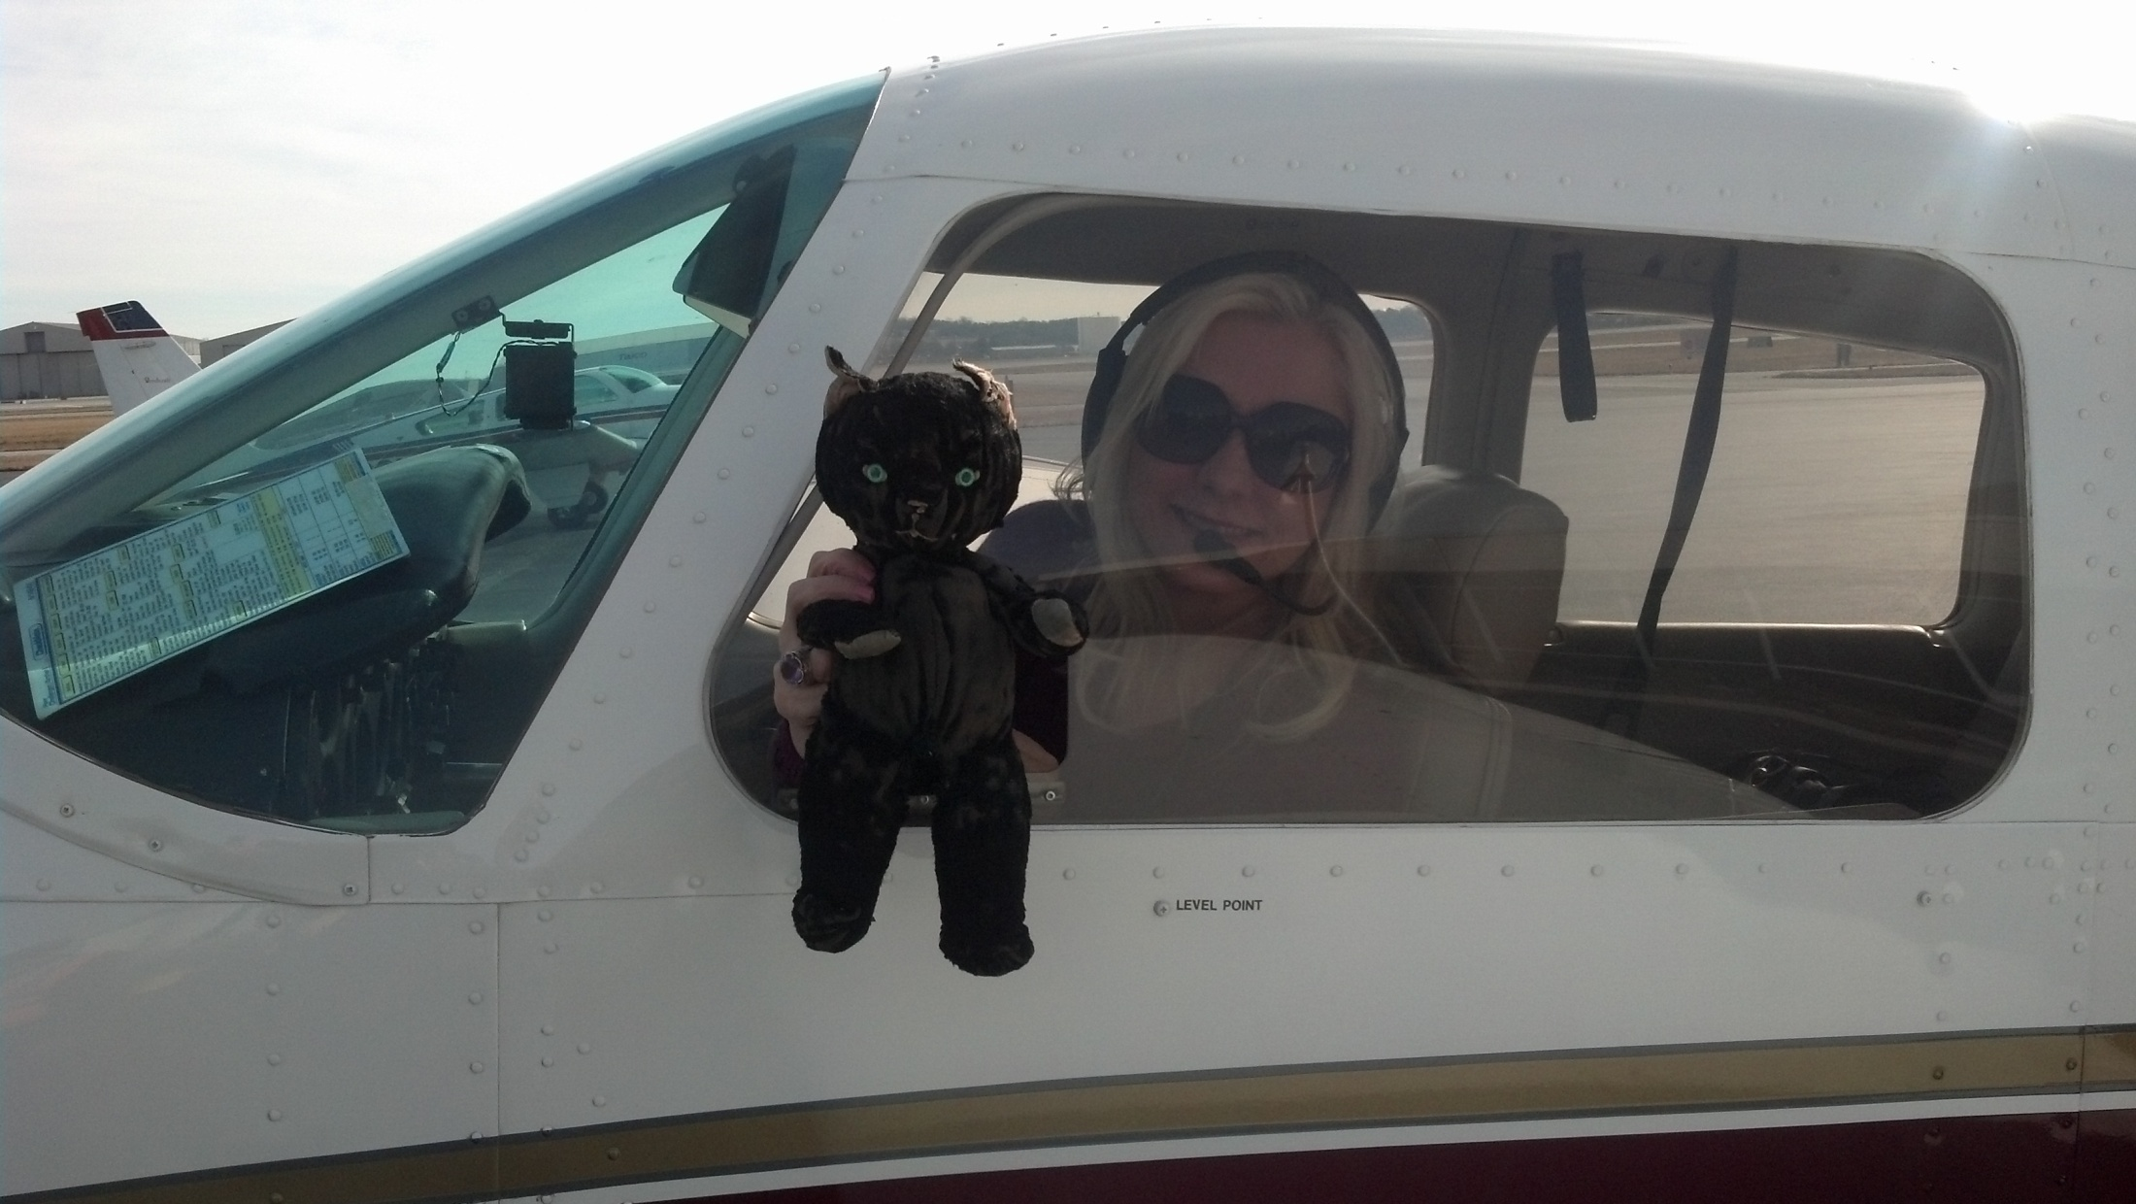
3

Slide 5
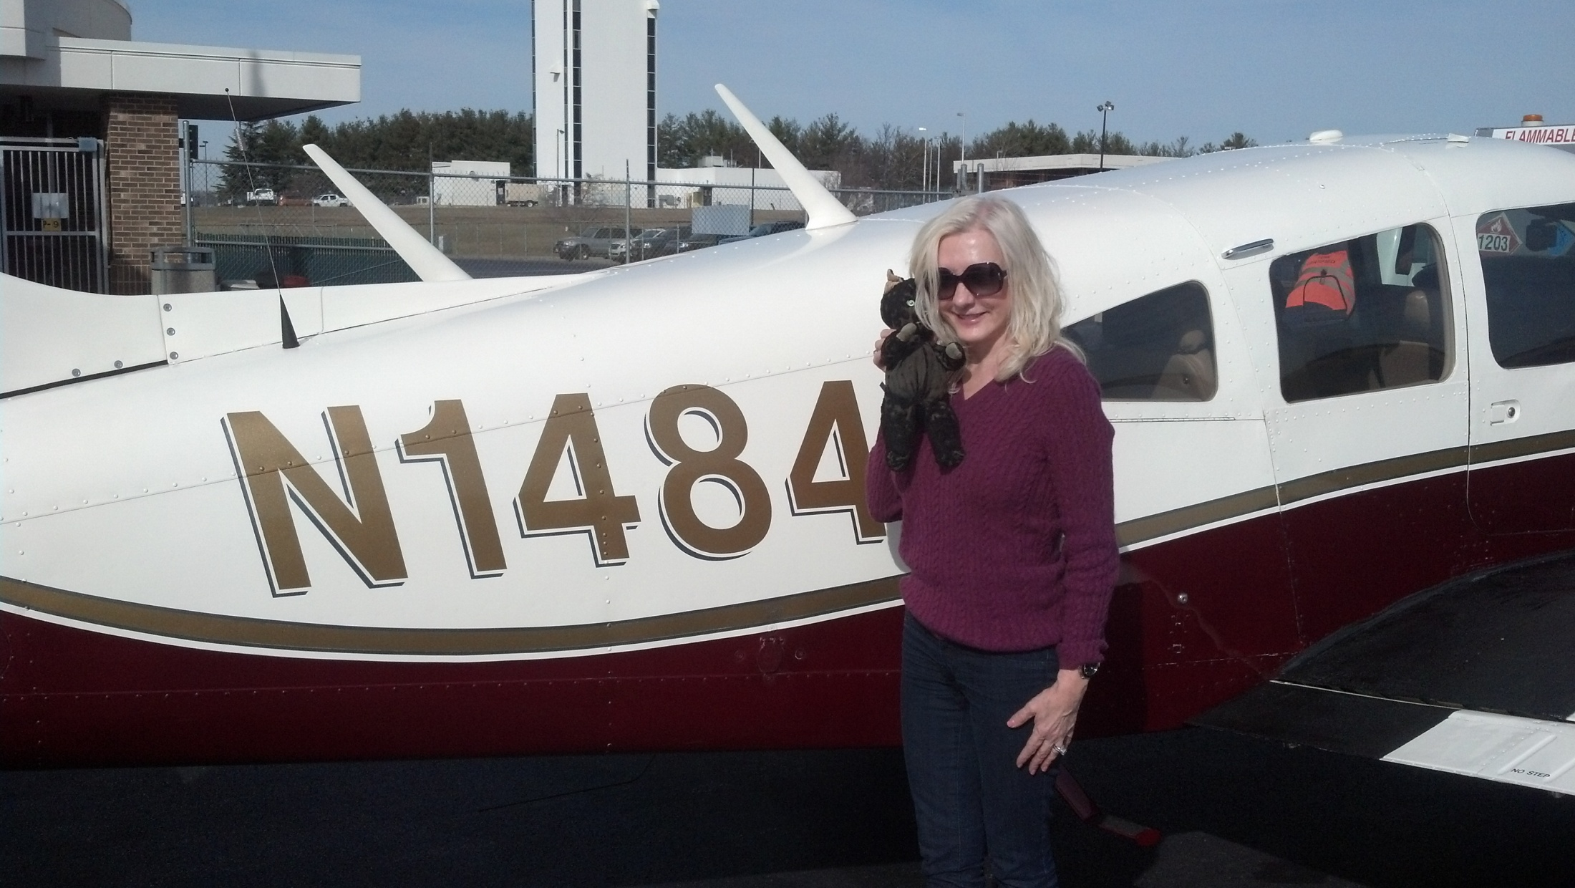

Slide 6
Carolyn Woodruff & Alosha Anatoliy: Dance Legends April 14, 2012
Dance Legends Video

